Slide 1


Final Year Project
SCU (School College University)
Supervised By: Mr. Muhammad Usman Karim

Slide 2
Project Team
Muhammad Fasih (22938)
Hanzala Tariq (20942)
Hanzala Iftikhar (24908)

Slide 3
Table of Content
Opportunity & Stakeholders
Solution
Progress Report Summary
Requirements
Software System (Design + Implementation + Testing)
Endeavour (Team + Work + Way of Working)
Next Steps
Prototype / Report

Slide 4
Opportunity & Stakeholders

Slide 5
Opportunity & Stakeholders
The SCU (School College University) Transportation initiative represents a transformative opportunity by introducing a holistic approach to transportation services. Its key stakeholders, including students, parents/guardians, and drivers, stand to benefit significantly.
Students gain improved access to education, extracurricular activities, and social interactions, encouraging holistic development.
Parents and guardians benefit from safe and reliable transportation.
Drivers are integral in providing efficient transportation, contributing to the system's success.

Slide 6
Opportunity & Stakeholders
This initiative offers several opportunities, such as empowering students and reshaping communities. It empowers young women, providing safe transportation for pursuing education and opportunities. Most importantly, it enhances education accessibility by removing barriers, ensuring that education is accessible to all. This support inclusivity and diversity in learning environments, ultimately contributing to a brighter and more equitable future.

Slide 7
Solution
We are aim to design a transportation system that benefits drivers, parents, and Students. Our strategy will ensure that students get an education quickly, safely, and reliably.
It will also benefit women by offering them driving employment.
We want to change the old approach of transportation.
Our goal is to make education and transportation in Pakistan better for everyone in our community, so they have a better future.

Slide 8
PROGRESS REPORT Summary

Slide 9
Requirements
Elicitation Techniques / Tools
Interviews:
Direct conversations with stakeholders to understand their needs, expectations, and concerns.
Questionnaires/Surveys:
Distributing structured sets of questions to a larger group to gather information about their preferences, priorities, and requirements.

Slide 10
Requirements
List of Different Users
Students(Passengers)
Parents/Guardians
Drivers
Use Cases:19
Functional Requirements: 9

Slide 11
Requirements
Functional Requirements:
Pick and Drop
Carpooling Service
Registration
Payment System
Complaint
Emergency Button/Alert System
Admin Panel
View Profile
Edit Profile

Slide 12
Requirements
Non Functional Requirements:
Usability
Intuitive user interface for easy navigation and accessibility for both students and drivers.
Security
Robust security measures to protect user data, and ensure passenger safety during transit by providing emergency button.

Slide 13
Design
Detailed Design:
Architectural Design
Use Cases
Use Case Fully Dressed Format
Activity Diagrams
Entity Relationship Diagram (ERD)
System Sequence Diagram (SSD)
Class Diagram

Slide 14
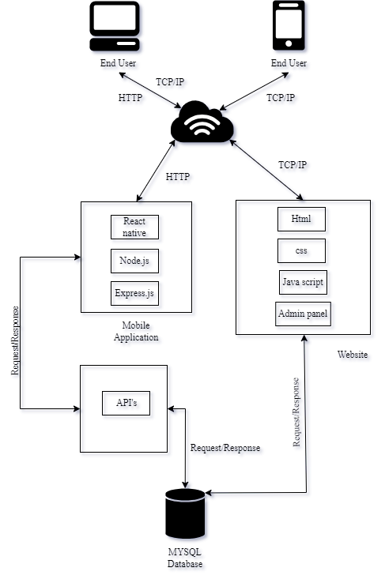
Architectural Design

Slide 15
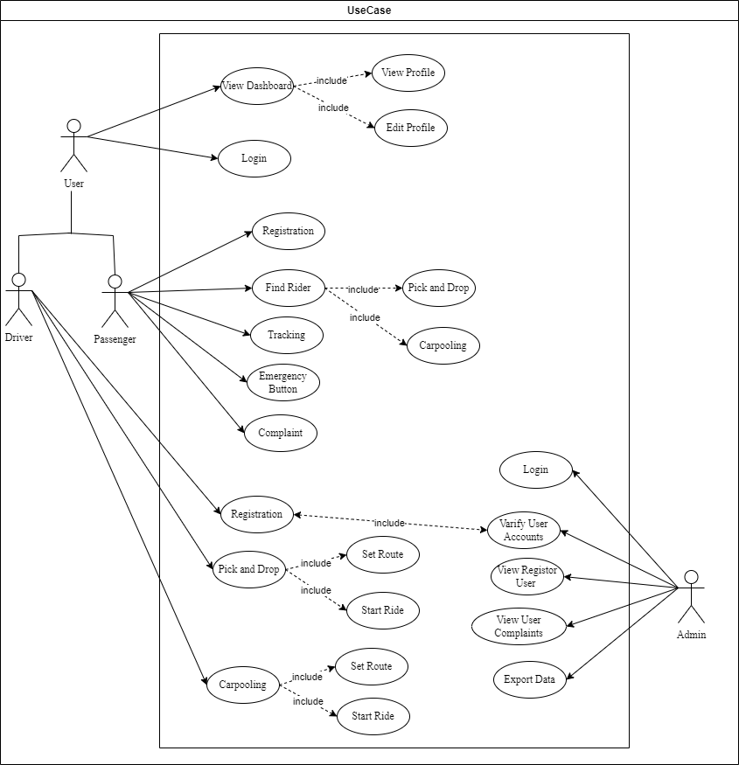
Use Case

Slide 16
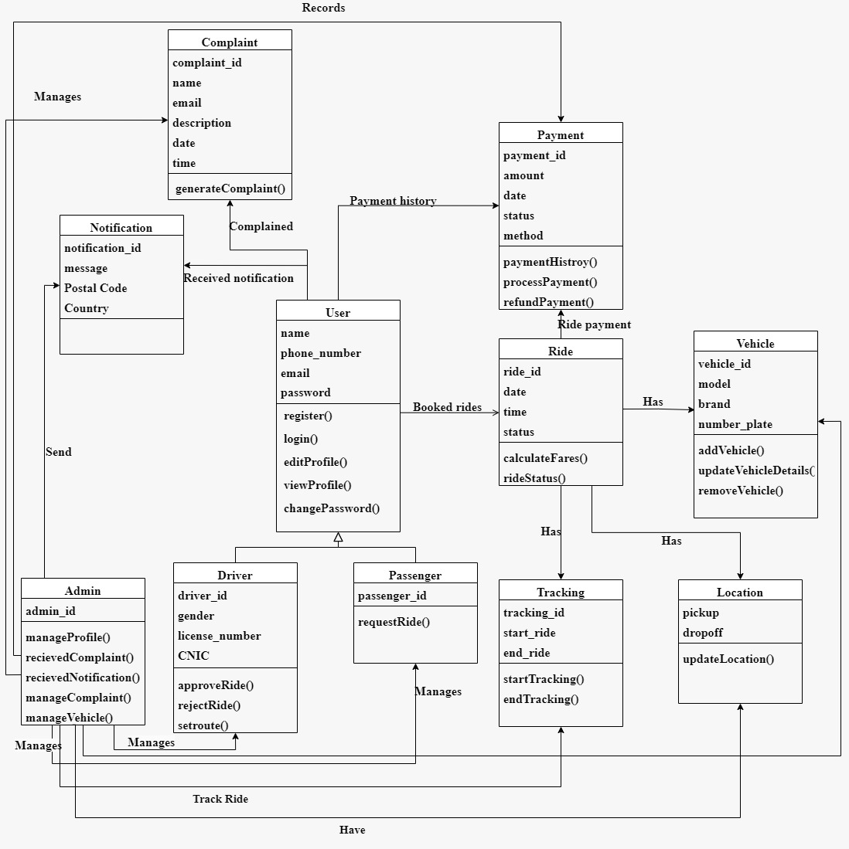
Class Diagram

Slide 17
Implementation
Development Tools & Technologies:
Visual Studio Code
Visual Paradigm
Draw.io
MS Word
Adobe Illustrator
Canva
GitHub
Postman

Slide 18
Implementation
Software Engineering Methodologies (Best Practices):
We have used the Scrum Agile Methodology for our project since it is more flexible and can adjust to constantly changing project scopes. This is how our project was carried out:
A minimum of fifteen to twenty minutes had been spent on a daily meeting.
Progress was discussed in meetings with the supervisor, which took place at least once or twice a week.
During the meeting, a list of work was created and deadlines were planned.
The group members then completed these tasks.
And progress was examined on a daily basis.

Slide 19
Implementation
React JS coding standard:
Easy, short, and readable variable and function names.
Camel case naming conventions followed.
Comments as much as needed but not more.
Use shortcut notation when it makes sense.

Slide 20
Implementation
List Libraries / Components / Web Services
React Native
Bootstrap
JavaScript
Express.js
HTML/CSS
Android Studio
PHP
Node.js

Slide 21
Implementation
Database
MYSQL
Tool for Online Team Collaborations
Google Meets
Zoom

Slide 22
Testing
Test Data | TD-1
Form | Login
Stakeholder | Passenger
Field | Username
Technique | Equivalence Class Partitioning
Valid | Valid: • {A, B, C, ...} • {a, b, c, …} • {1, 2, 3, 4, …}
Invalid | Invalid: • {!, @, >, $, %, ., (, &, *, ^, ), <, #, ?, /, ;, :, ’, ”, `, ~, =, +, -, _, …} • {}

Slide 23
Testing
Test Data | TD-2
Form | Login
Stakeholder | Passenger
Field | Password
Technique | Equivalence Class Partitioning
Valid | Valid: • {A, B, C, ...} • {a, b, c, …} • {!, @, >, $, %, (, &, *, ^, ), <, #, ?, /, ;, :, ’, ”, `, ~, =, +, -, _,….} • {1, 2, 3, 4, …}
Invalid | Invalid: • {}

Slide 24
Endeavour

Slide 25
Endeavour
Roles of your team members:
Muhammad Fasih=>
App Front-end, App Back-end, Documentation
Hanzala Iftikhar=>
App Front-end, App Back-end, Documentation
Hanzala Tariq=>
Web Front-end, Web Back-end, Documentation

Slide 26
Endeavour
Software Development Process:(Agile Methodology: Scrum)
Planning:
Requirement Gathering: Understanding the project's objectives, goals, and client/stakeholder requirements.
Scope Definition: Defining project scope, deliverables, constraints, and timelines.
Initial Design: Creating a high-level architecture and design plan.
Design:
Documentation: Creating design documents, including system architecture diagrams, detailed specifications, Use cases Fully Dressed format, database schemas, and any necessary technical documentation.
Technology Selection: Choosing appropriate technologies, frameworks, and tools for development.

Slide 27
Endeavour
Implementation:
Front-end Development: Building user interfaces, interactions, and logic using technologies like React Native in this context.
Back-end Development: Creating server-side logic, APIs, and databases using technologies like Node.js, Express.js, and MYSQL databases.
Integration: Integrating front-end and back-end components and connecting with external APIs or services.
Testing:
Unit Testing: Testing individual components/modules for functionality and correctness.
Black Box Testing: Focuses on testing the functionality and behavior of the software without requiring knowledge of its internal structure, code, or implementation details.

Slide 28
NEXT STEPS

Slide 29
Work Breakdown Structure
Data Collection and Processing
(Sep-Oct)
Requirements Gathering
Working on System Workflow
Development Tools Learning
Application Front-End Development
(Oct-Nov)
Tools Integration
Building Interface
Web Development
(Nov-Dec)
Front-End , Back-End
Admin Panel Development
Application Back-End Development
(Dec-Jan)
API’s Integration
Database Connection

Slide 30
Challenges
Learning Curve
Setup and Environment
Front-End Development Challenges
Database Connection
API Integration
Back-End Related Challenges

Slide 31
Prototype & Report

Slide 32
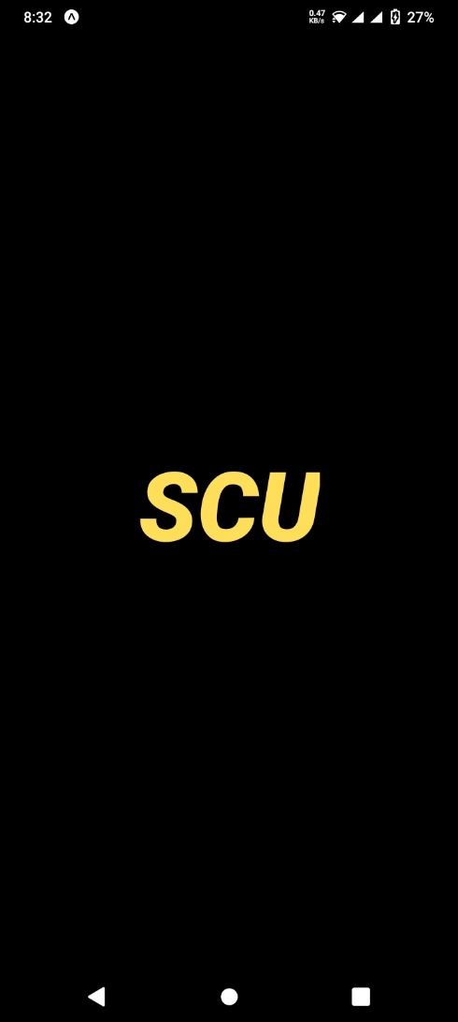
Prototype

Slide 33
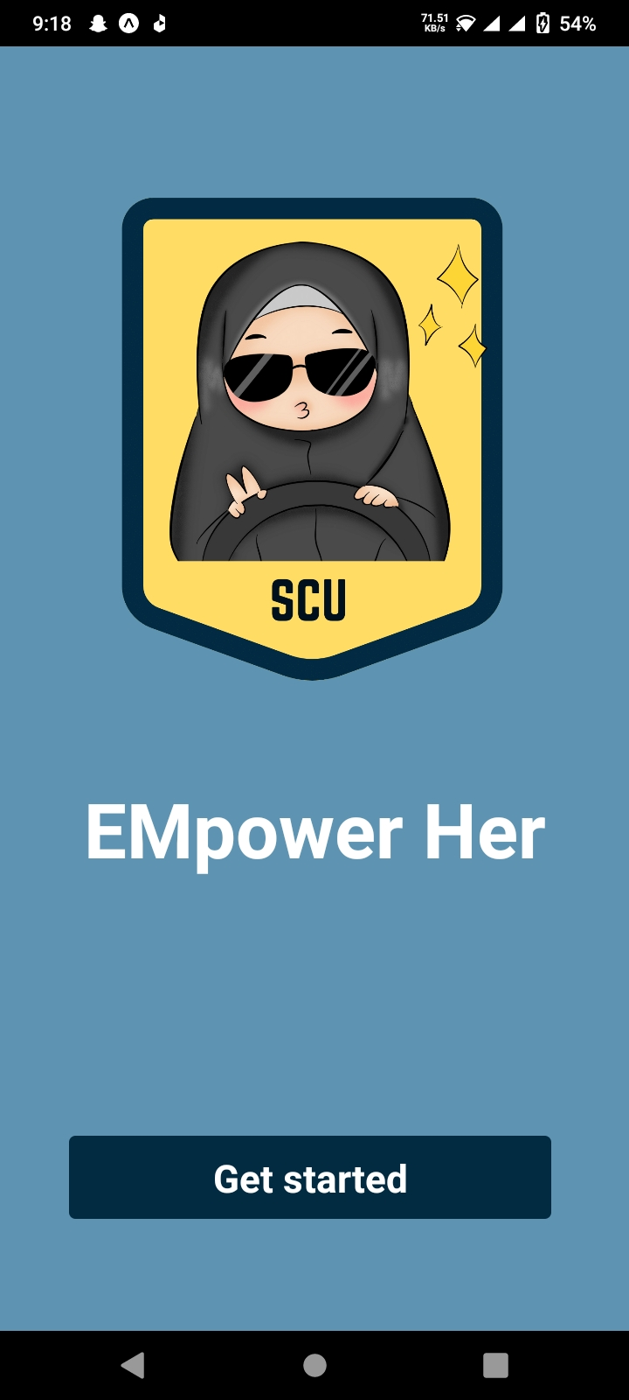
Prototype

Slide 34
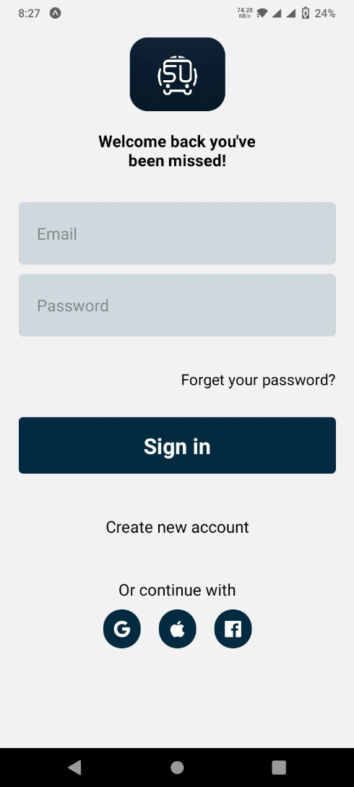
Prototype

Slide 35
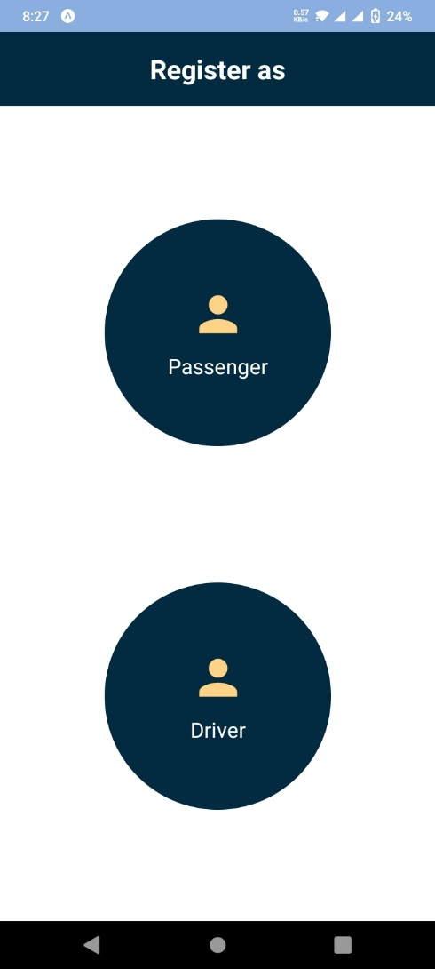
Prototype

Slide 36
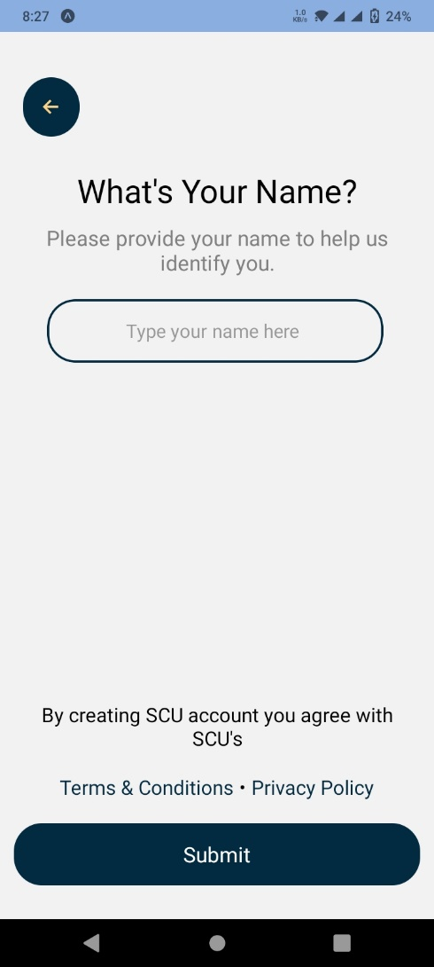
Prototype

Slide 37
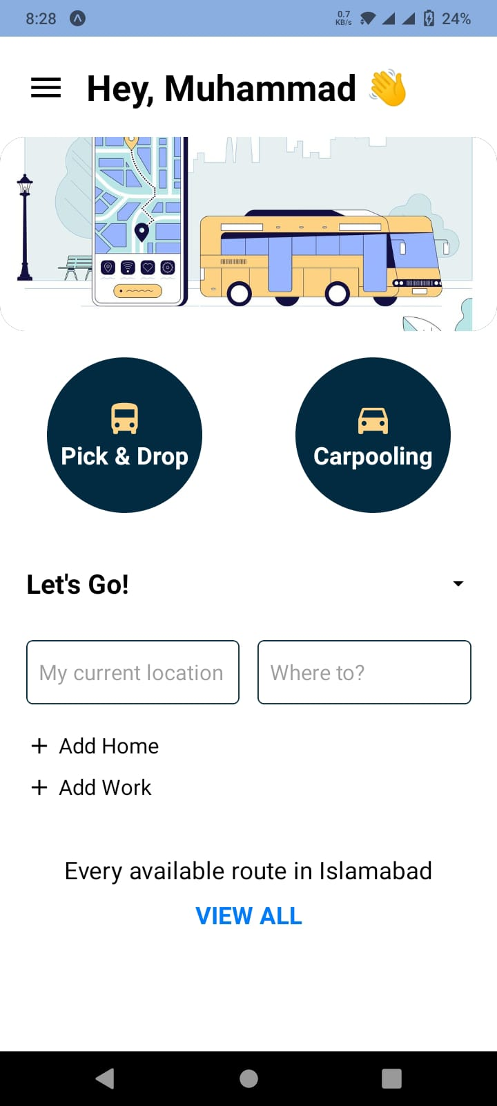
Prototype

Slide 38
Report
Chapter 1: Introduction
Chapter 2: Literature / Market Survey
Chapter 3: Requirement Analysis
Chapter 4: System Design
Chapter 5: Implementation
Chapter 6: Testing & Evaluations
Chapter 7: Conclusion & Outlook

